Slide 1
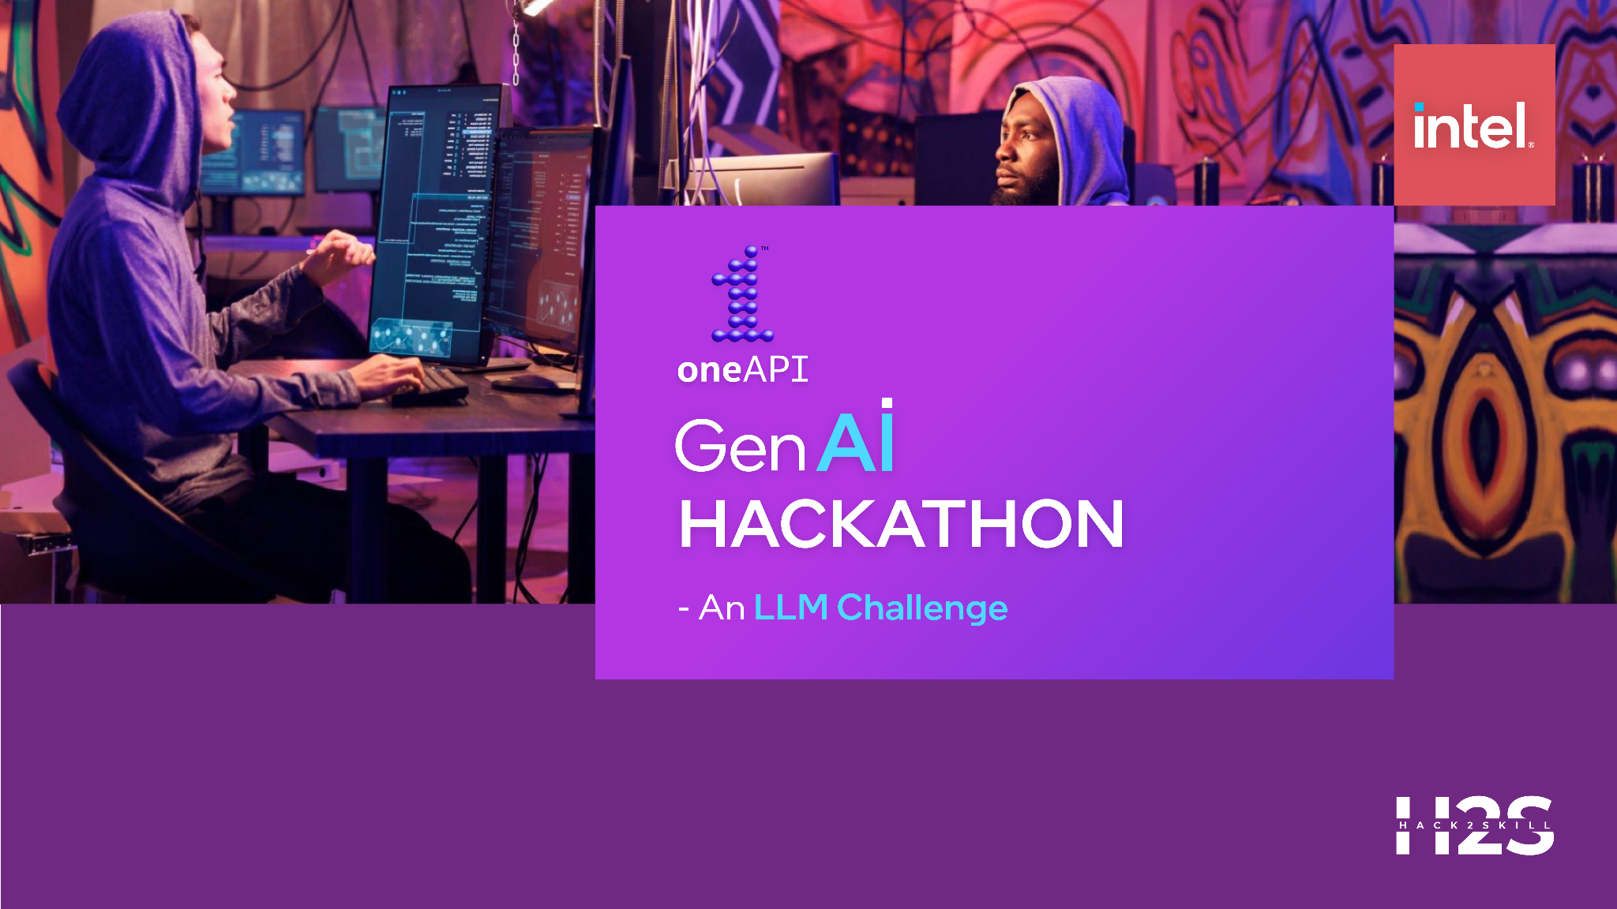
Team Name :Maveriks
Problem Statement :Generative AI Large Language Models Fine Tuned For Legal Practice Platform

Slide 2
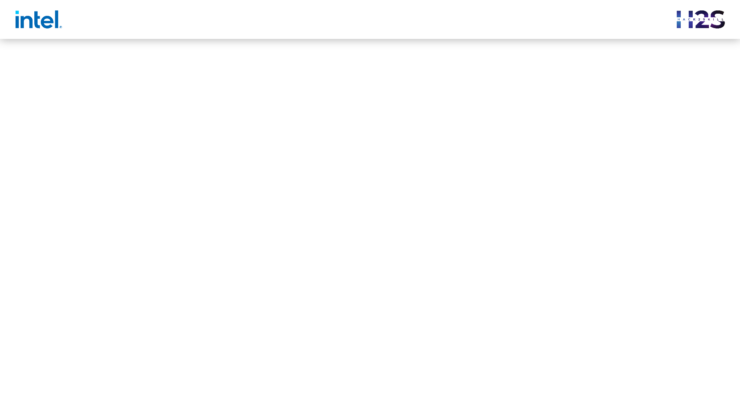

Problem Statement:
Empower legal professionals with cutting-edge Generative AI technology. Participants are tasked with fine tuning an innovative Legal Practice Platform powered by Large Language Models (LLM) tailored to meet the specific needs and challenges faced by legal professionals.

Slide 3

Agenda
OBJECTIVE
Use case
workflow
Platform Features
implementations
Architectural dIagrAM

Slide 4

OBJECTIVE
Empower legal professionals with cutting-edge Generative AI technology. Participants are tasked with fine tuning an innovative Legal Practice Platform powered by Large Language Models (LLM) tailored to meet the specific needs and challenges faced by legal professionals.

Slide 5
USE CASE
A Critical scenario for prioritizing the cases for the judgment & hearing.
Analyzing a Case’s severity with not just a single parameter but multiple constraints
Efficient time utilization & slot allocation.
Augmenting the existing DCM approach with Intel® AI Analytics Toolkit

Slide 6
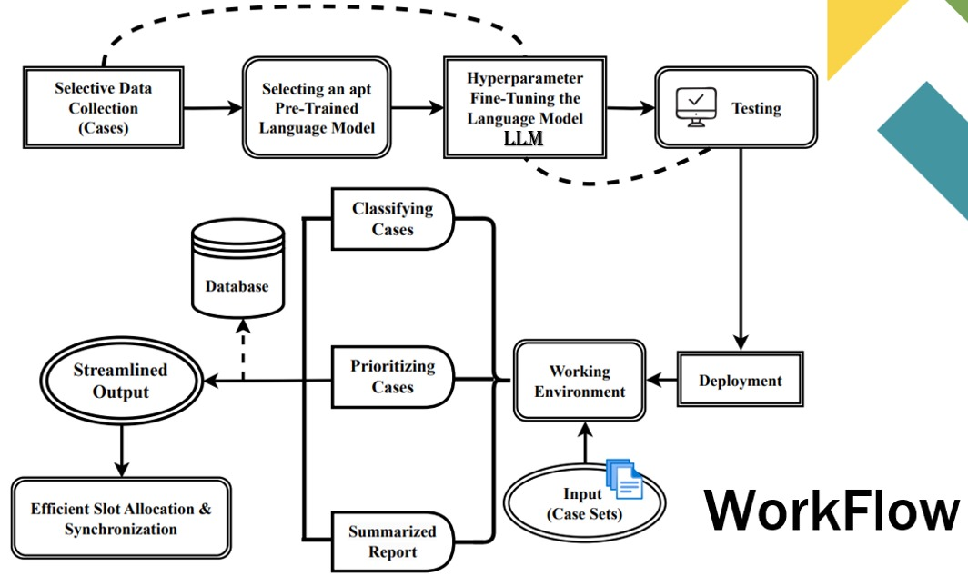

Slide 7

Platform Features
Highlight key features:
Intel® AI Analytics Toolkit Integration
Document Understanding and Summarization
Legal Research Optimization
Case Outcome Prediction
Contract Review Automation
Client Communication Enhancement

Slide 8

Implementation Details
Queueing the cases for the hearing and judgement has always been very hectic, adopting the existing DCM systems is neither considered to be reliable or state-of-the-art approach. We propose an Augmented way of streamlining the cases by Hyperparameter Fine-Tuning a Pre-Trained Language Model, in other words an enhanced Artificial Intelligence model that is Specialized in the field of Judiciary; Assists & Plots our flow of work i.e. a Large language Model (LLM) that Classifies the case’s Severity & urgency w.r.t. multiple parameters defined.

Slide 9
ARCHITECTURAL DIAGRAM

Slide 10
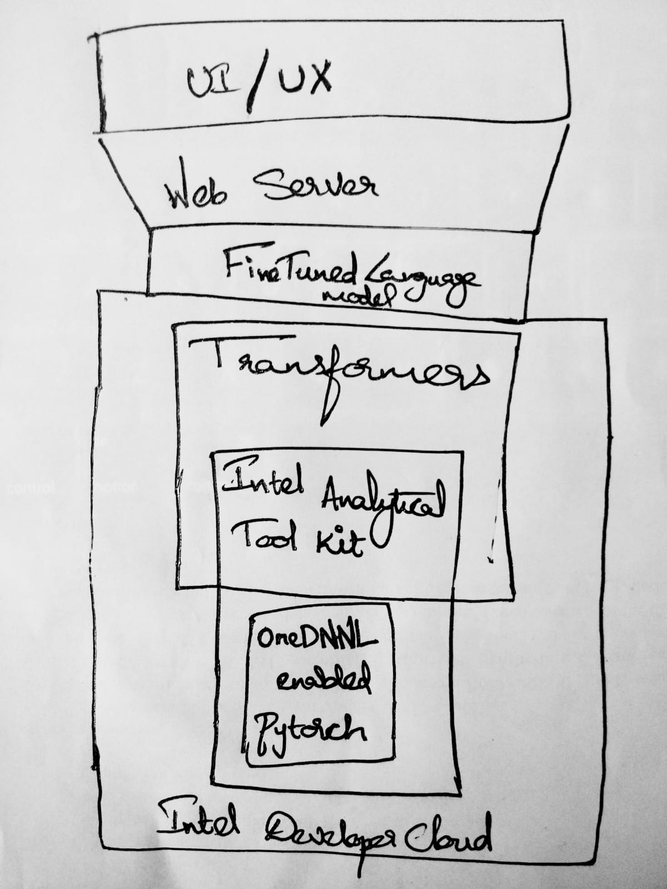

Slide 11
SCREENSHOTS OF Intel® DEVELOPMENT CLOUD ACCOUNT

Slide 12
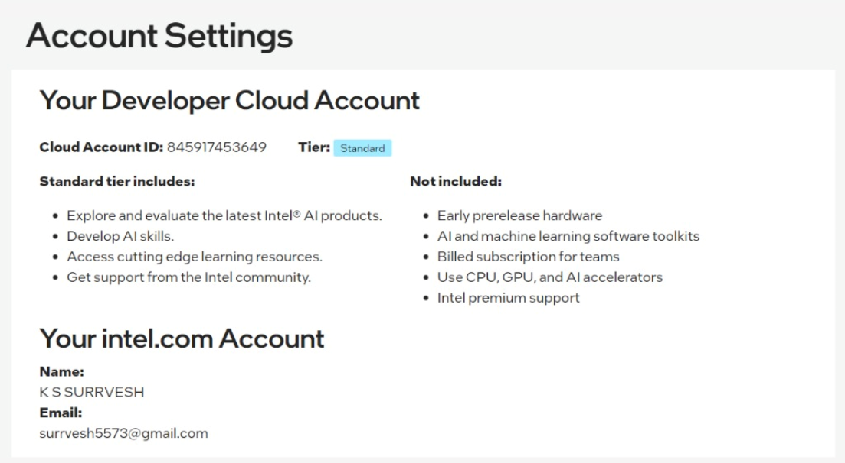

Slide 13
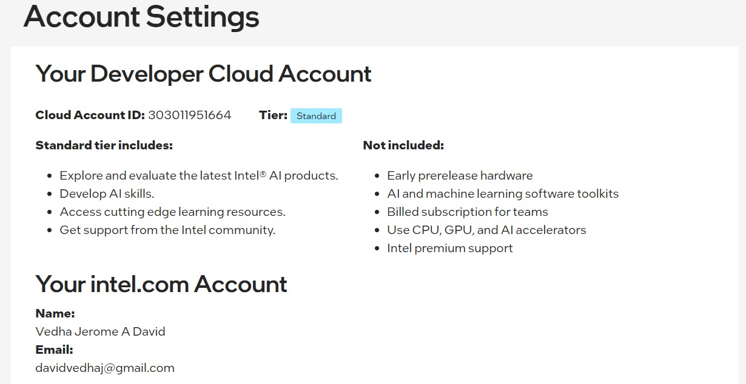

Slide 14
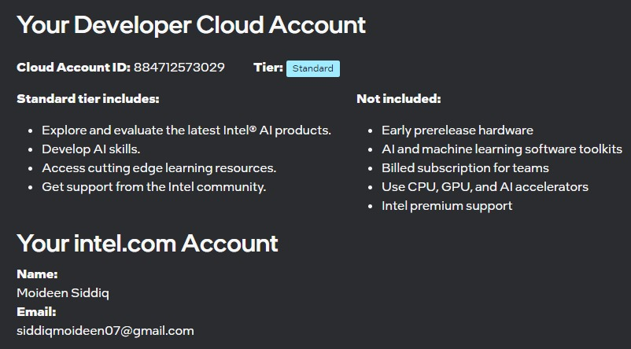

Slide 15

Summary
In conclusion, the development of LegalAssist represents a significant step towards leveraging artificial intelligence and advanced analytics to enhance the efficiency and effectiveness of legal professionals. The prototype successfully integrates OpenAI's Language Model, Intel Analytics Toolkit, and the Intel Developer Cloud to create a versatile legal assistance tool.

Slide 16
Summary
Throughout the development process, our team gained valuable insights into the challenges and opportunities within the legal industry. The combination of natural language processing, predictive analytics, and automated contract review offers a powerful set of tools to streamline legal research, assess case outcomes, and expedite contract reviews.

Slide 17
Summary
LegalAssist's user-friendly interface and seamless integration with cutting-edge technologies provide legal professionals with a valuable resource for making informed decisions and improving overall productivity. The iterative development process allowed us to fine-tune the application and incorporate user feedback, ensuring that the tool aligns closely with the needs of legal practitioners.

Slide 18
Summary
As we look to the future, there is immense potential for further enhancements and expansions. The incorporation of advanced legal analytics, continuous improvement of natural language processing capabilities, and additional features like collaboration tools and document automation will contribute to the evolution of LegalAssist.

Slide 19
Summary
We envision LegalAssist as a catalyst for positive change within the legal field, empowering professionals to navigate the complexities of legal research, case prediction, and contract review with greater ease and confidence. We remain committed to refining and expanding the application, staying at the forefront of technological advancements to deliver innovative solutions for the legal community. The journey does not end here, and we look forward to further advancements and collaborations in the realm of legal technology.

Slide 20
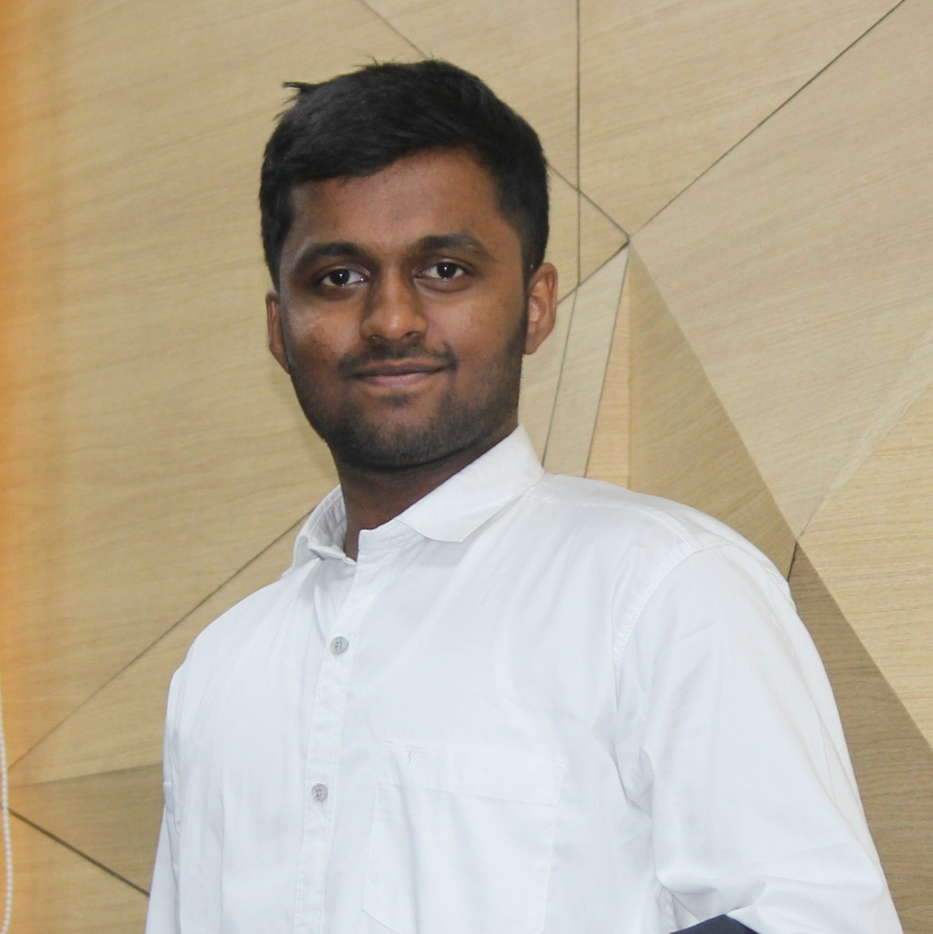

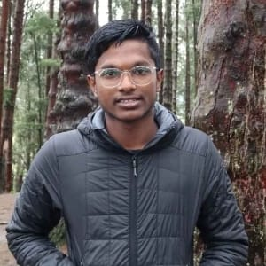
Meet our team
Surrvesh K S
Siddiq moideen
DAVID VEDHA JEROME A
Team Leader
Team Member 1
Team Member 2

Slide 21


